Slide 1
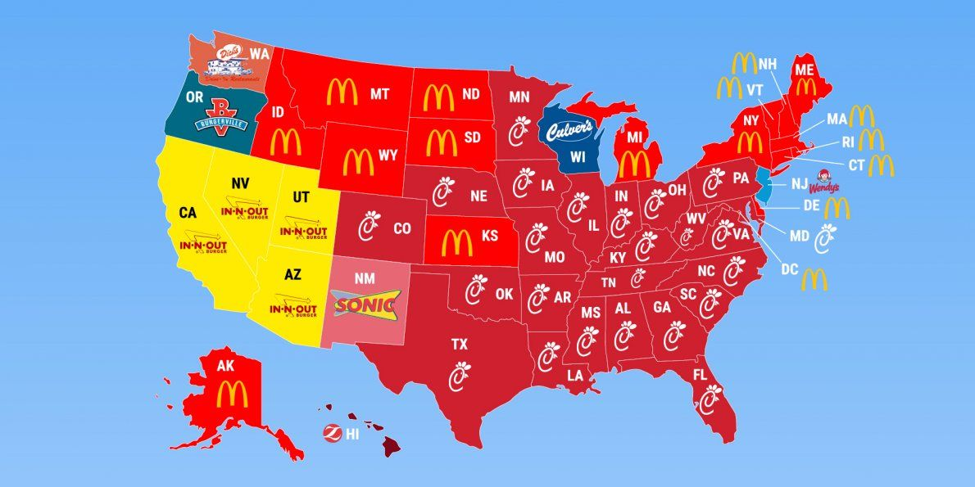
Exploratory Data Analysis on Fast Food Restaurants
Submitted by :Varalakshmi Arcot

Slide 2
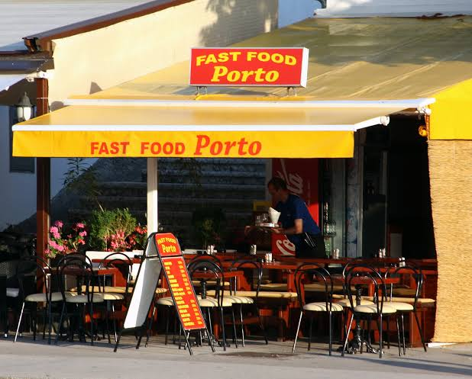
History
A fast food restaurant, also known as a quick service restaurant (QSR) within the industry, is a specific type of restaurant that serves fast food cuisine and has minimal table service.
The first fast food restaurant originated in the United States with White Castle in 1921.
Fast Food refers to food that can be prepared and served quickly. It can come from many places: sit-down restaurants, take-out, drive-thru, and delivery. Fast food is popular because the food is inexpensive, convenient, and tastes good.

Slide 3
Project Information
The goal of the analysis is to figure out Fast food restaurants in USA for all states , major and minor cities .
Fast Food Restaurants Dataset: This dataset contains information about Address, City, Country, Keys, Latitude, Longitude, Name, Postal Code, Province, Websites of fast food restaurants in USA.
Dataset has 10 columns and 10000 records

Slide 4
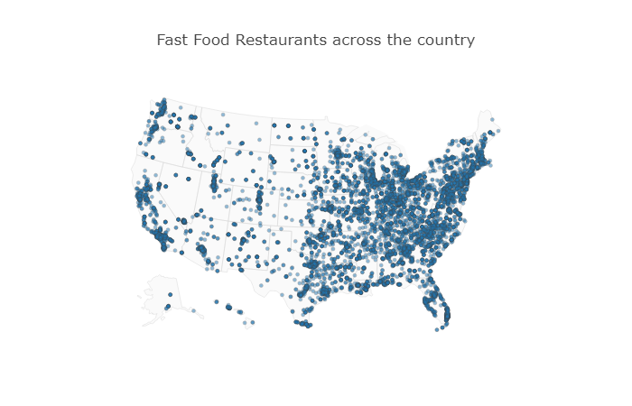
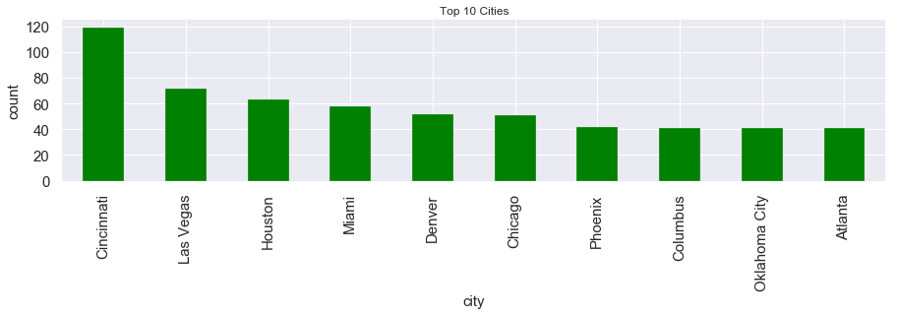
Cincinnati City has largest number of fast food restaurants in USA

Slide 5
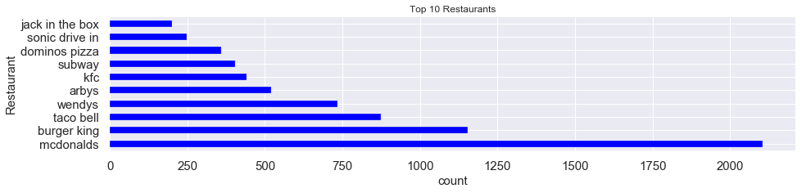
TOP Fast food restaurant "McDonald's" in USA

Slide 6
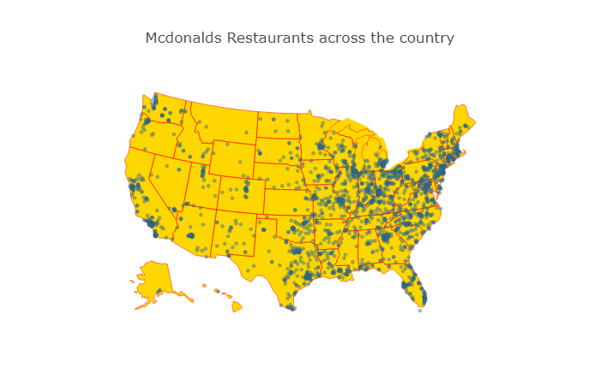
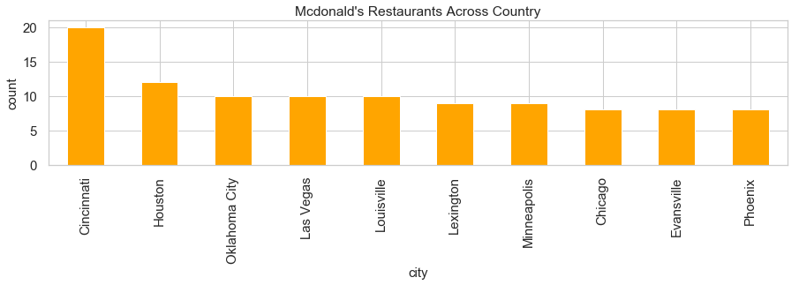
Cincinnati City has largest number of Mcdonald's Restaurants

Slide 7
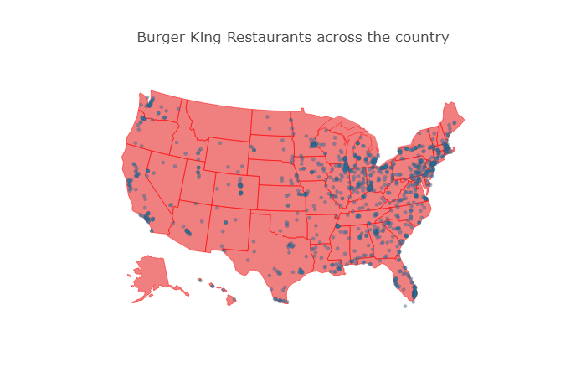
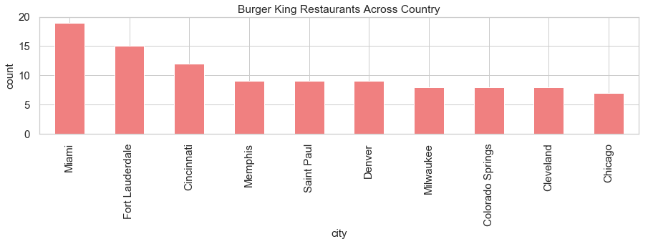
Mami City has largest number of Burger King Restaurants

Slide 8
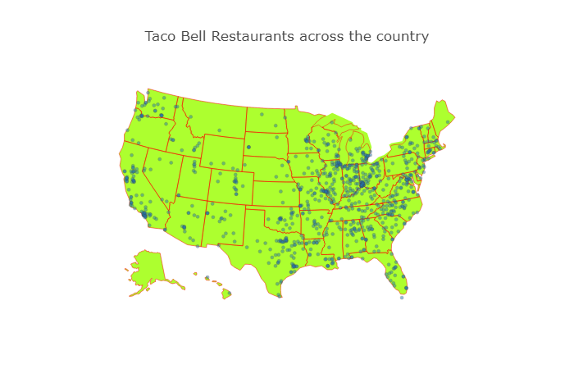
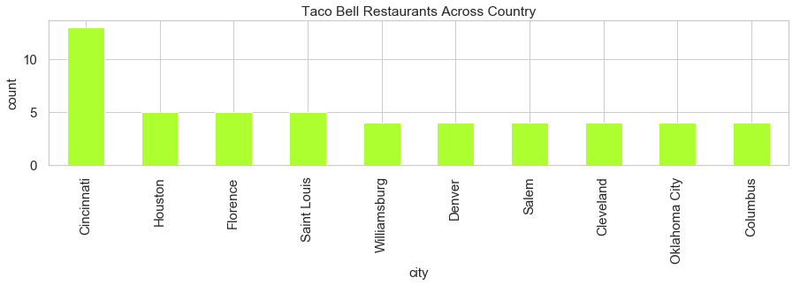
Cincinnati City has largest number of Taco Bell Restaurants

Slide 9
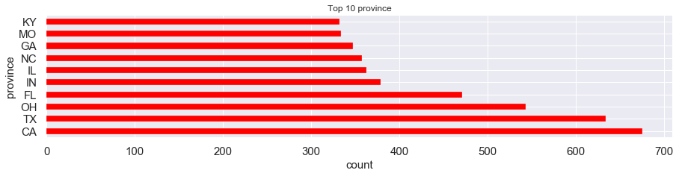
CA(California) is the province with largest number of fast food restaurants in USA

Slide 10
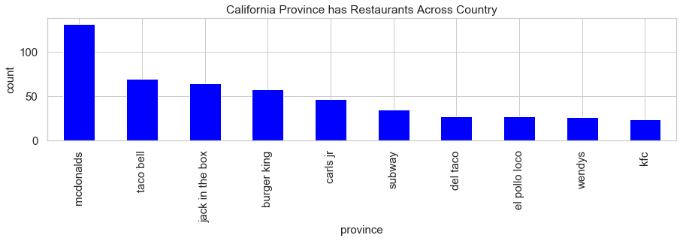
CA(California) is the province with largest number of Mcdonalds Restaurants in USA

Slide 11
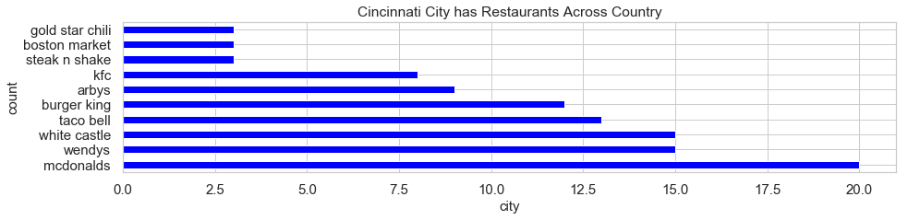
Cincinnati City has highest number of restaurants from top 10 cities. It has highest number of Mcdonald's Restaurants

Slide 12
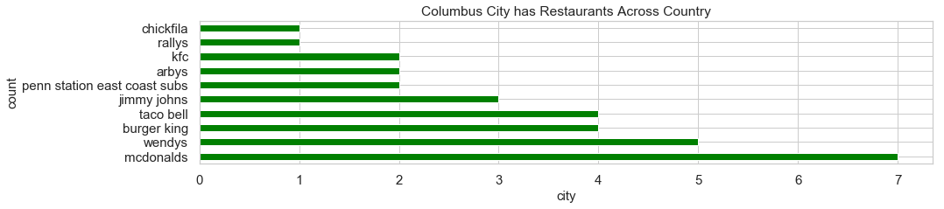
Columbus City has least number of restaurants from top 10 cities. It has largest number of Mcdonald's Restaurants

Slide 13
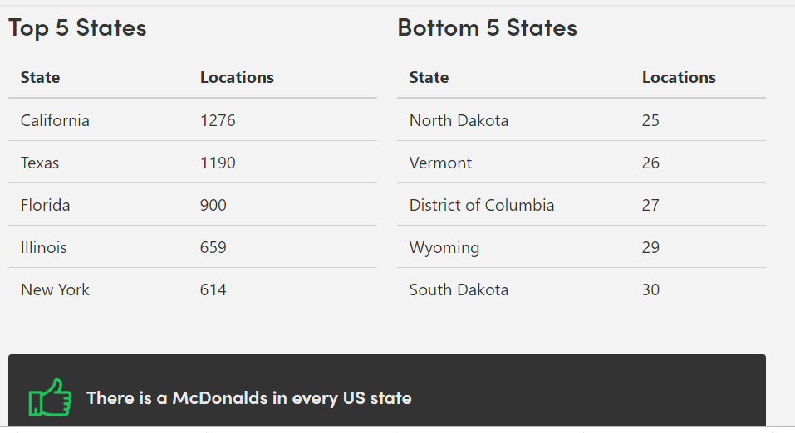
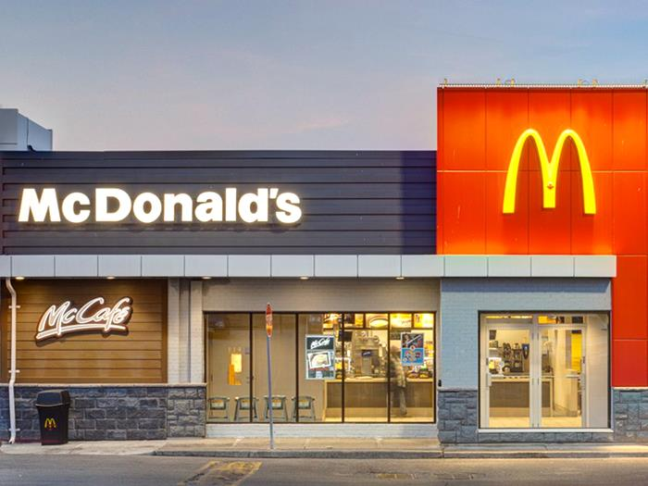
Conclusion
The United States is the leading country , considering major and minor cities has the most McDonald's restaurants.
McDonald's has a total of 13,826 locations in USA as of November 26, 2019.
California has the largest number of McDonald's with 1276 locations about 9% in USA.

